Slide 1
Crossover in EAs 2: building blocks etc
Richard A. Watson
Natural Systems group, ECS, Southampton University, UK

Slide 2
Revision
What is the problem with sex
  Two-fold cost of sex
Some evolutionary biology models for the benefit of sex
  Fisher/Muller
  Muller’s Ratchet

Slide 3
Revision: Fisher/Muller hypothesis (1930)
B
B
Proportion of population
A+B
A
A
ab
time
Linkage disequilibrium created by new mutations in finite populations.
Decrease in L.D. beneficial because removes competition between simultaneously segregating beneficial alleles
i.e. sex is advantageous because it allows alleles to be selected for independently
Notes:
Y axis

Slide 4
As we saw before
00100000000010000001 3
00000100000010001000 3
Asexuals can only produce more of these two genotypes
How many possible genotypes can uniform crossover create from these two genotypes?
How many from one-point crossover?

Slide 5
Uniform crossover creates all of these
00100000000010000001 3
00100000000010000000 2
00100000000010001001 4
00100000000010001000 3
00100100000010000001 4
00100100000010000000 3
00100100000010001001 5
00100100000010001000 4
00000000000010000001 2
00000000000010000000 1
00000000000010001001 3
00000000000010001000 2
00000100000010000001 3
00000100000010000000 2
00000100000010001000 3

Slide 6
Focussing variation
‘focussing search’, Prügel-Bennett (ECS)
i.e. uniform crossover of these two strings
00101001010110111110100010010010000001010110
00101001011110111110100010010000000111010010
----------?-------------------?----??-------
Only creates variation at loci where the parents differ whereas mutation creates variation at all loci
(See also “Is the common good” Chen 1999)

Slide 7
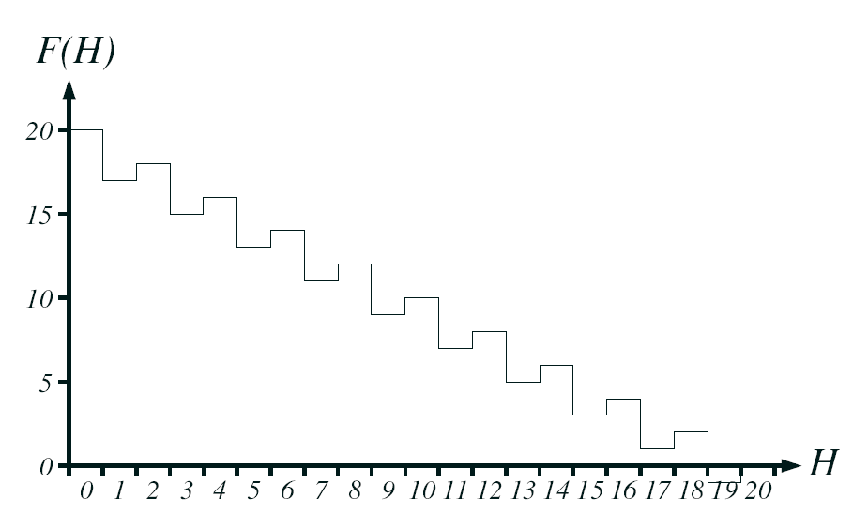
Hurdles problem (Prügel-Bennett)
Two-point mutation.
Mutations to jump final hurdle occur with prob?
  1/L²
Prob of uniform crossover for two individuals that differ by 4 bits?
  1/2⁴

Slide 8
One point crossover creates only these
00100000000010000001
00100000000010000000
00100000000010001000
00100100000010001000
00000100000010001000
Two of these are one-point mutations from one of the parents, but the rest are more than one point mutations – therefore quite unlikely for mutation hill-climber to find
And these particular ones each occur with probability 1/k not 1/2^{k}

Slide 9
Is there a further bias here that might be exploited?
What’s special about this subset of strings that can be made by one-point (or low rates of crossover) that uniform crossover cannot make?
Ans: The bits that appear together in the offspring are close to each other on the chromosome/genome.
i.e.: The bits that stay together are physically linked.

Slide 10
Schemata and building blocks
Holland: Schema Theorem (1975)
  Increase in frequency of schemata of above average fitness
Goldberg: Building Block Hypothesis (1989)
  Emphasis on combining fit low-order schemata into higher-order schemata of higher fitness

Slide 11
Schemata and building blocks
What is the highest order schema that contains these individuals?
11110100
01010101
11011101
11011100
*1*1*10*
What order is it?
What is its defining length?
What is a Building-block?

Slide 12
Building-block ideas
Holland 1975, Goldberg 1989 and others proposed that this is the reason that GAs work well
  A GA first finds small schemata
  Then crossover puts small schemata together to find bigger ones
  And bigger and bigger until the whole problem is solved.
Mitchell and Forrest (1991-1995)
  Set out to test this is correct by making an idealised problem where low order schemata of short defining length and above average fitness are known to be present
  And they can be combined together to make bigger ones
  “Royal Roads”

Slide 13
Royal Roads
11111111******************************************************** 8
********11111111************************************************ 8
****************11111111**************************************** 8
************************11111111******************************** 8
********************************11111111************************ 8
****************************************11111111**************** 8
************************************************11111111******** 8
********************************************************11111111 8
1111111111111111************************************************ 16
****************1111111111111111******************************** 16
********************************1111111111111111**************** 16
************************************************1111111111111111 16
11111111111111111111111111111111******************************** 32
********************************11111111111111111111111111111111 32
1111111111111111111111111111111111111111111111111111111111111111 64

Slide 14
What happened?
GAs work fine on RRs… but
Random mutation hill-climber works better!
→ general failure to demonstrate anything a GA can do that a hill-climber cannot do!
a good example of
  enthusiastic attachment to an overcomplicated approach
  i.e. a simpler algorithm is better
  but also, idealising benefit to test hypothesis (=success)
also
  concatenated trap functions (Deb and Goldberg 1993)
  macro-mutation hill-climber/ headless chicken test (Jones 1995)
failure of the BB school: if its inferior on an idealised problem then the BB school of GA theory must be rubbish

Slide 15
Some successes in showing something crossover can do that hill-climbers cannot – without using building blocks
Shapiro and Prugel-Bennet (1997) ‘two wells’/’basin with a barrier’
Thomas Jansen (2001)
  ‘Gap’ function
P1: 11110101111101011111
P2: 11111011100111111111
C1: 11111??11??1?1?11111

Slide 16
Some successes with building blocks
Hierarchical-IFF: Watson (2000)
  Hierarchical modular building-block problem
  Hill-climber O(2^{N/2})
  GA with tight linkage can solve in O(N²log²N)
P1: 1111111100000000
P2: 0000000011111111
C1: 1111111111111111
.
Jansen (2001)
  ‘Gap’ function w. bonus for tight linkage of 1s
P1: 0001111111100000
P2: 1110000000011111
C1: 1111111111111111

Slide 17
The good news and bad news
Good news
  It verifies that some kind of GA on some kind of problem can utilise advantage of building-block recombination under some circumstances
  It solves this kind of problem in polynomial time whereas any kind of hill-climber (or uniform crossover) takes exponential time
Bad news
  Its not a standard GA or a ‘standard’ problem
  What’s it got to do with any practical engineering problem?
  What’s it got to do with any real biology?
So, since then I’ve been trying to make a simpler model that shows the same thing ...

Slide 18
A simple two module model
Nucleotide sites within a gene are grouped both functionally and physically by virtue of shared transcription and translation. →
A simple form of biologically-real modularity.
i
gene 1
j
gene 2
✓✓✓✗ ✗ ✓✗ ✗✓✓✓ ✓✓✓✓✓✓✓✓✓✓✓
Assume mutations in the same gene have stronger synergy than mutations in different genes
  i.e. more beneficial mutations there are within a gene, the more effect additional mutations have. Equivalently, the closer to proper/complete functioning the gene is, the more important mutations are.
  e.g. each deleterious mutation halves binding affinity - exponential decay with distance from ideal sequence

Slide 19
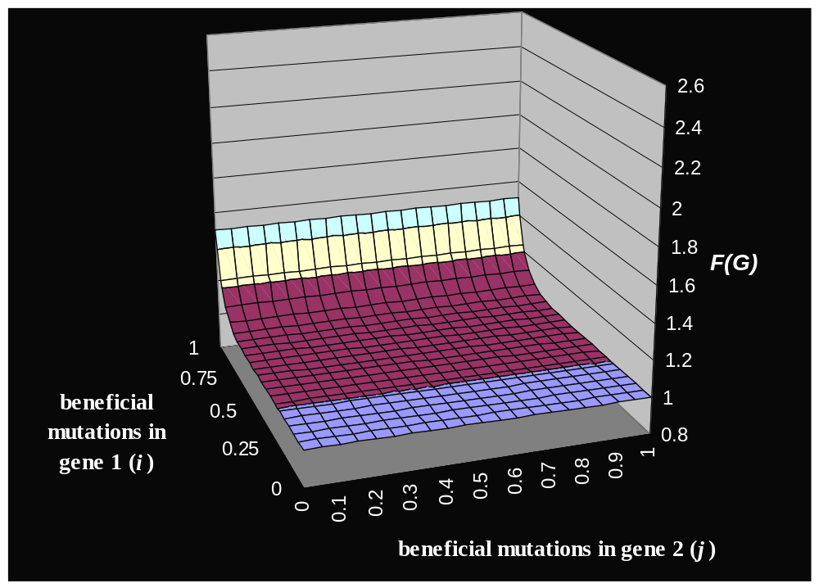
Multiplicative in gene 1 only
e ^{i}

Slide 20
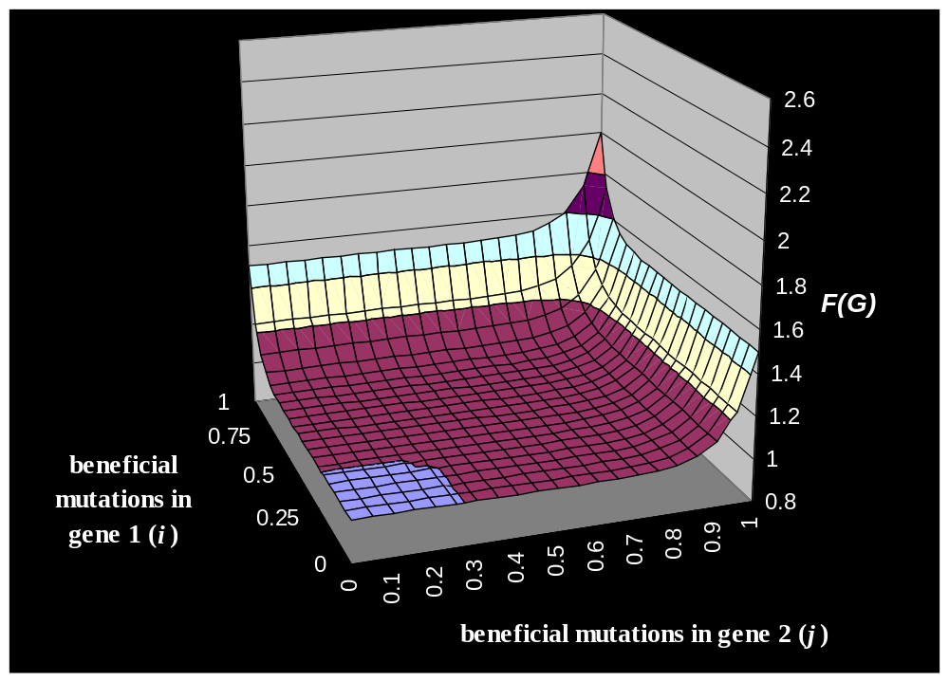
Synergistic epistasis within genes
(e ^{i}+e ^{j})

Slide 21
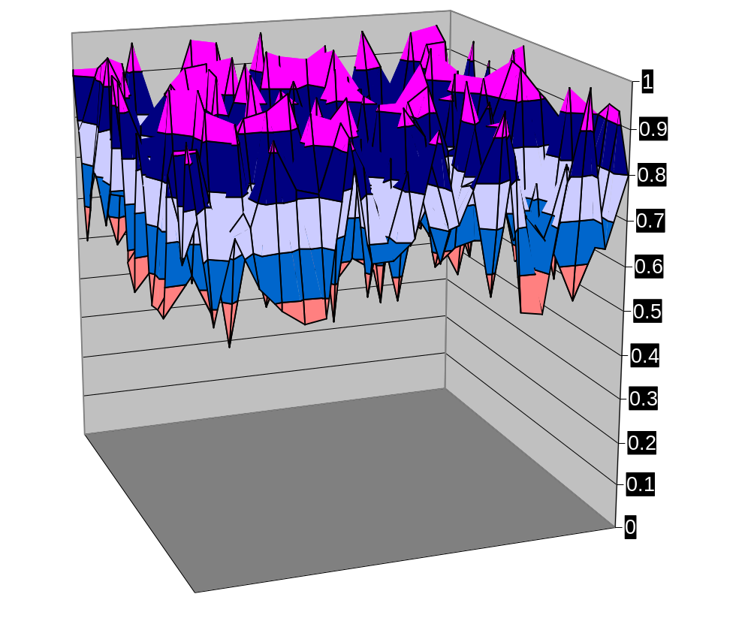
Random epistasis among all loci
R_{i,j}
F(G)
1
0.75
beneficial
0.5
mutations in
gene 1 (
i
)
0.25
0.7
0.8
0.9
0
0.4
0.5
0.6
0
0.1
0.2
0.3
beneficial mutations in gene 2 (
j
)

Slide 22
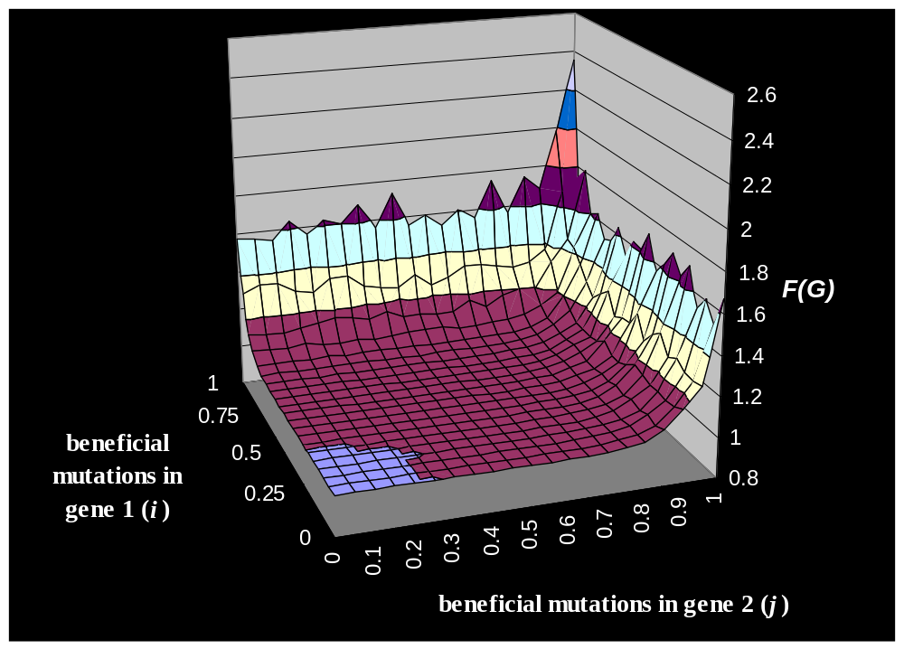
Synergistic epistasis within genes and random epistasis
(e ^{i}+e ^{j})R_{i,j}

Slide 23
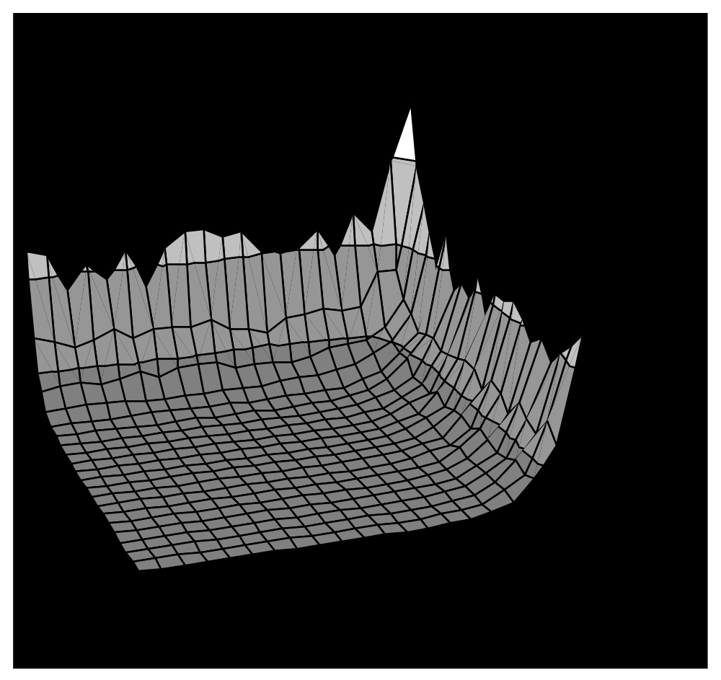
Simple analysis: without recombination
2^{k}
Finding peak of one gene is easy.
Finding the peak of the second gene without disrupting the first is difficult.
k
^{k}
T 2^{k}
gene 1
gene 2

Slide 24
Simple analysis: with recombination
gene 1 gene 2
----✓✓✓✓✓✓✓✓----✓✓✓✓✓✓✓✓---
gene 1 gene 2
----✓✓✓✓✓✓✓----✗✗✓✗✗✓✓✗---
gene 1 gene 2
----✓✓✓✗✗✓✗✗----✓✓✓✓✓✓✓✓---
k
T k
gene 1
gene 2

Slide 25
Simulation study
Sufficient diversity required.
Multi deme model
    50 demes of 200 individuals each
    Island migration (0.005)
    Mutation (0.03 per site)
    Recombination: crossover 0.0, 0.013 (1/L), 0.5
    Two genes, 40 sites each
    1% Elitism: retain fittest 2 individuals in each deme
Simulation example…

Slide 26
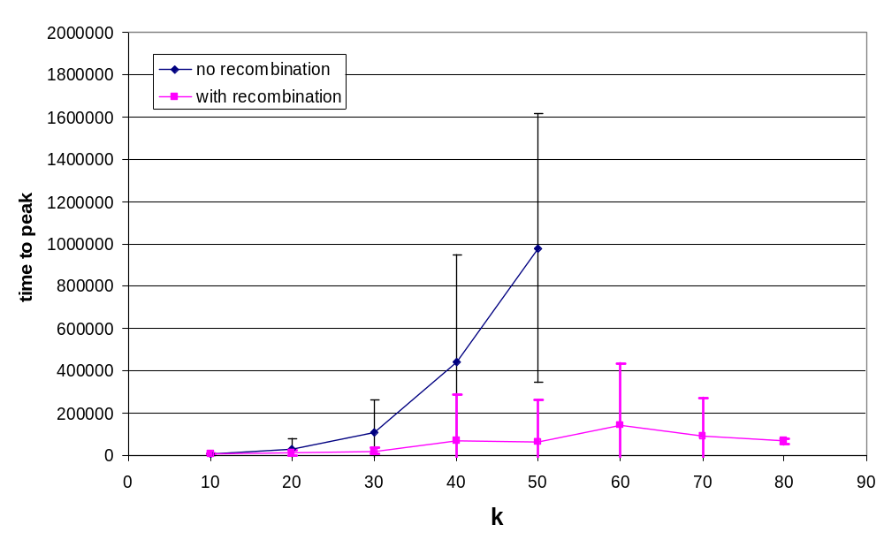
Simulation results

Slide 27
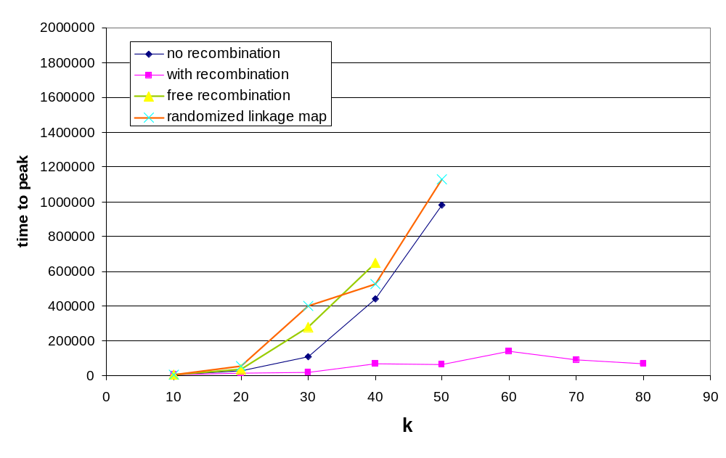
Simulation results - controls

Slide 28
In this two-module model
Selection on individual nucleotide-site mutations finds good alleles
Selection on alleles (separated by recombination) puts them together
Two scales of optimisation are required

Slide 29
Summary
EC and EB have very different approaches to modelling sex…
Evolutionary biology models largely focus on decreasing associations
Evolutionary computation seems to focus on making/retaining associations
Some EC models show that GA with sex can solve some things that hill-climbers cannot solve
  Some use selection on individual bits (Prugel-Bennett, Jansen)
  Some use Building blocks (Watson, Jansen)

